Slide 1
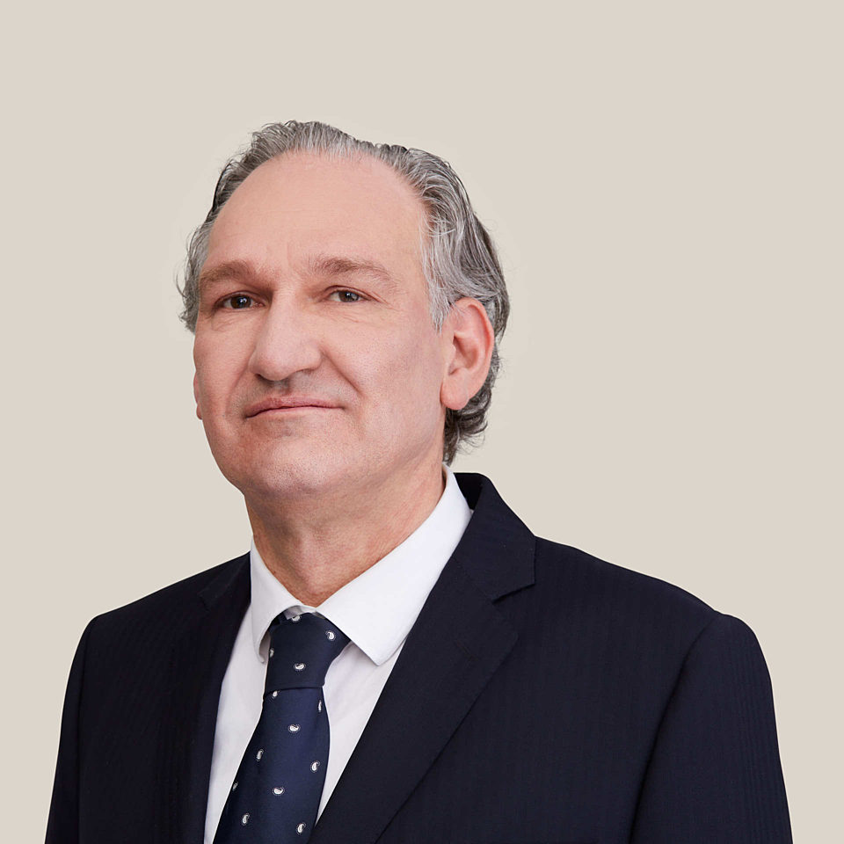
Session 1: Reaped benefits and peculiarities for individuals
In particular, my panel will examine the taxation of dividends (Article 10), interest (Article 11), capital gains (Article 13), directors' fees (Article 15) and pensions (Article 16) in the context of individuals under the new double tax treaty.
The session will begin with an overview of these treaty articles, followed by an in-depth analysis of specific topics such as (i) dividends, interest and capital gains in relation to emigrating individual shareholders, (ii) individuals resident in Belgium holding shares in Dutch special investment vehicles such as the Exempt Investment Institution and the Fiscal Investment Institution, (iii) the impact of the Belgian annual tax on securities accounts and the Belgian Cayman tax, (iv) directors' fees and the demarcation from remuneration received as an employee, and (v) various pension and annuity issues that exist under the current treaty and will continue under the new treaty.
Panel members:
- Martijn Verwijs, Senior manager (International) wage tax at ASML
- Pepijn van Eijk, Tax Consultant at KPMG Meijburg & Co
- Griet vanden Abeele, Tax Lawyer (Partner) at Tiberghien Belgium
- Angie Clocheret, Advisor International Tax, Belgian Federal Tax Administration
Panel Chair: Frank Pötgens – Professor of International and European Tax Law at Vrije Universiteit Amsterdam / Partner at De Brauw Blackstone Westbroek

Slide 2
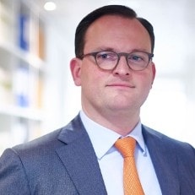
Session 2: Understanding challenges and prospects for business with emphasis on PE presence
“During the second panel, the treaty provisions most relevant for companies and individuals performing cross-border business are examined. Topics to be addressed include permanent establishment, personal income tax and payroll tax-related issues concerning home working employees (articles 5, 7 and 15). Further, the position of frontier workers under the treaty will be discussed, including social security aspects. Other relevant PE issues can be discussed as well.”
Panel members:
- Jasper Korving, Senior Tax Manager at Deloitte / Assistant Professor at Maastricht University
- Veerle Lerut, Tax Lawyer (Counsel) Employee Benefits at Baker McKenzie Belgium
- Evelien Luyck, Staff member of the MAP team / Belgian negotiator of the Belgian-Dutch tax treaty
- David Tiesinga, Policy advisor / treaty negotiator at Dutch Ministry of Finance
Panel Chair: Tim Wustenberghs – Tax Partner at Deloitte Legal / Teaching professor at University of Antwerp

Slide 3
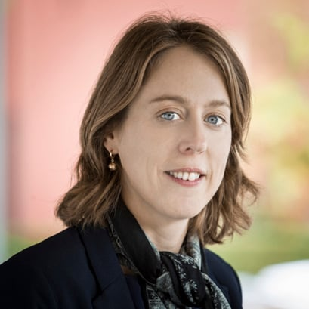
Session 3: Delving into the classics: how recent Belgian and Dutch case law keeps the narrative on tax treaty abuse and beneficial ownership relevant
“During the third panel, recent developments in the area of tax treaty abuse and beneficial ownership, both from a Belgian and Dutch perspective, will be discussed. The panelists will address the case law of the courts of both countries and will address which developments under the existing Belgian-Netherlands tax treaty will also carry over to the new Belgian-Netherlands tax treaty.”
Panel members:
- Linda Brosens, Tax Lawyer at Loyens & Loeff / Professor at the University of Antwerp
- Loes van Hulten, Professor of Fiscal economy at Erasmus University Rotterdam / Senior Manager at Deloitte
- Ward Willems, Belgian Federal Tax Administration, Large Enterprises Section (International Tax Unit)
Panel Chair: Margriet Lukkien - Tax Partner at Loyens & Loeff

Slide 4
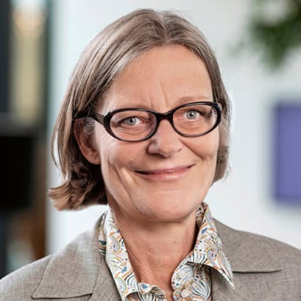
Session 4: A hands-on perspective on the functioning of Dispute Prevention and Resolution mechanisms
“The fourth panel will address dispute prevention and resolution under the new Belgian-Netherlands tax treaty. The panel will cover the mutual agreement provision (article 24), reviewing the relevant changes between the existing mutual agreement provision (including the Multilateral Instrument) and the new mutual agreement provision, such as the removal of the arbitration provision”
Panel members:
- Rhys Bane, Associate at Lubbers, Boer & Douma
- Filip Haes, Belgian Delegated Competent Authority responsible for all MAP and BAPAs related to TP
- Harm Mark Pit, Netherlands Tax Administration
Panel Chair: Caroline Docclo – Tax lawyer at Loyens & Loeff / Professor at Université Libre de Bruxelles and University of Liège

Slide 5
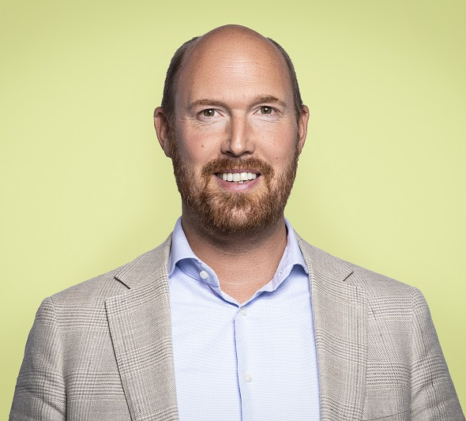
Session 5: Assessing the interplay between the Dutch legal entity tax qualification rules and Belgian domestic legislation
“In the final session of the day, the panelists will examine the interplay between the new Dutch entity tax classification rules and the new tax treaty approach to hybrid entities. They will assess the effects of these rules on cross-border situations and discuss the practical implications for entities operating in both jurisdictions.”
Panel members:
- Ilse Lagerweij, Tax associate at DLA Piper
- Bart Peeters, Professor at University of Gent, University of Antwerp, University of Liège
Panel Chair: Gijs Fibbe– Baker Tilly Netherlands N.V.

